Slide 1
Annual Review – Year Ending March 2024
Neena Mahal
Interim Chair
Welcome & Introductions

Slide 2
Overview
Escalation – Level 4
NHS Forth Valley at a Glance
Service Developments
Improving Quality & Safety
Achievements and Challenges
Performance
Q&A Session

Slide 3
Governance
Leadership
Culture
Performance
Quality & Safety

Slide 4
Ross McGuffie
Chief Executive
NHS Forth Valley in 2023/24

Slide 5
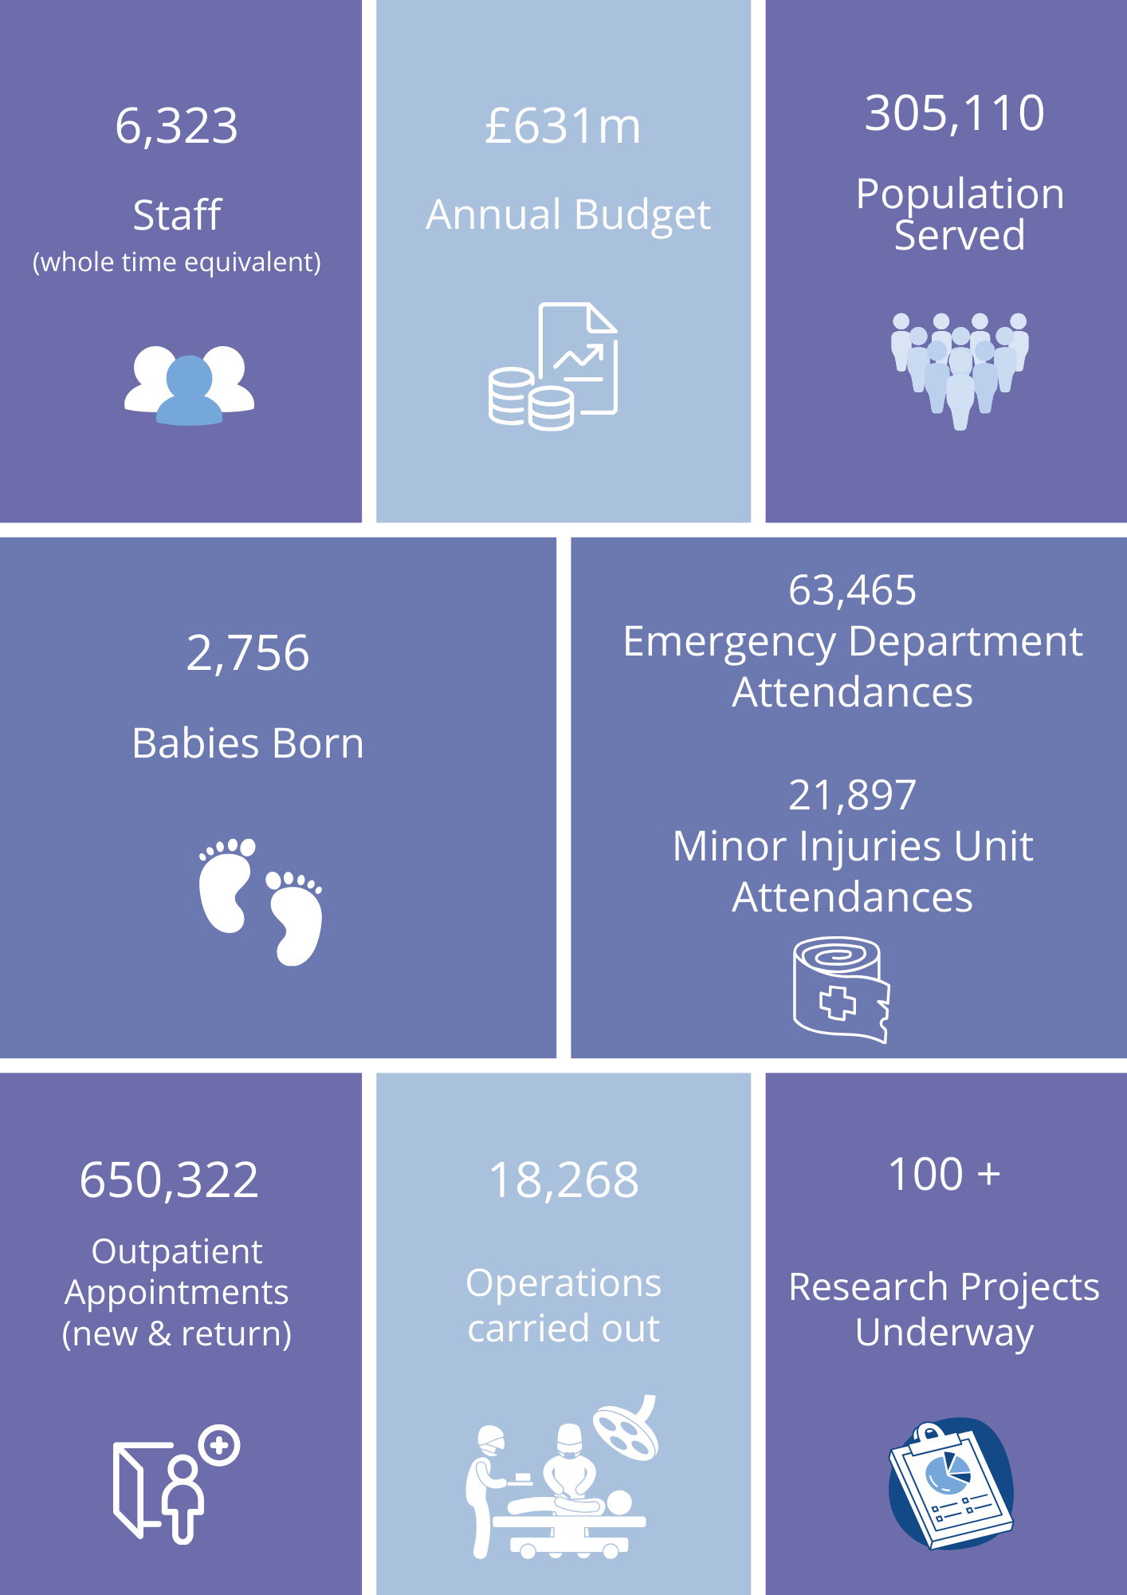
At a Glance

Slide 6
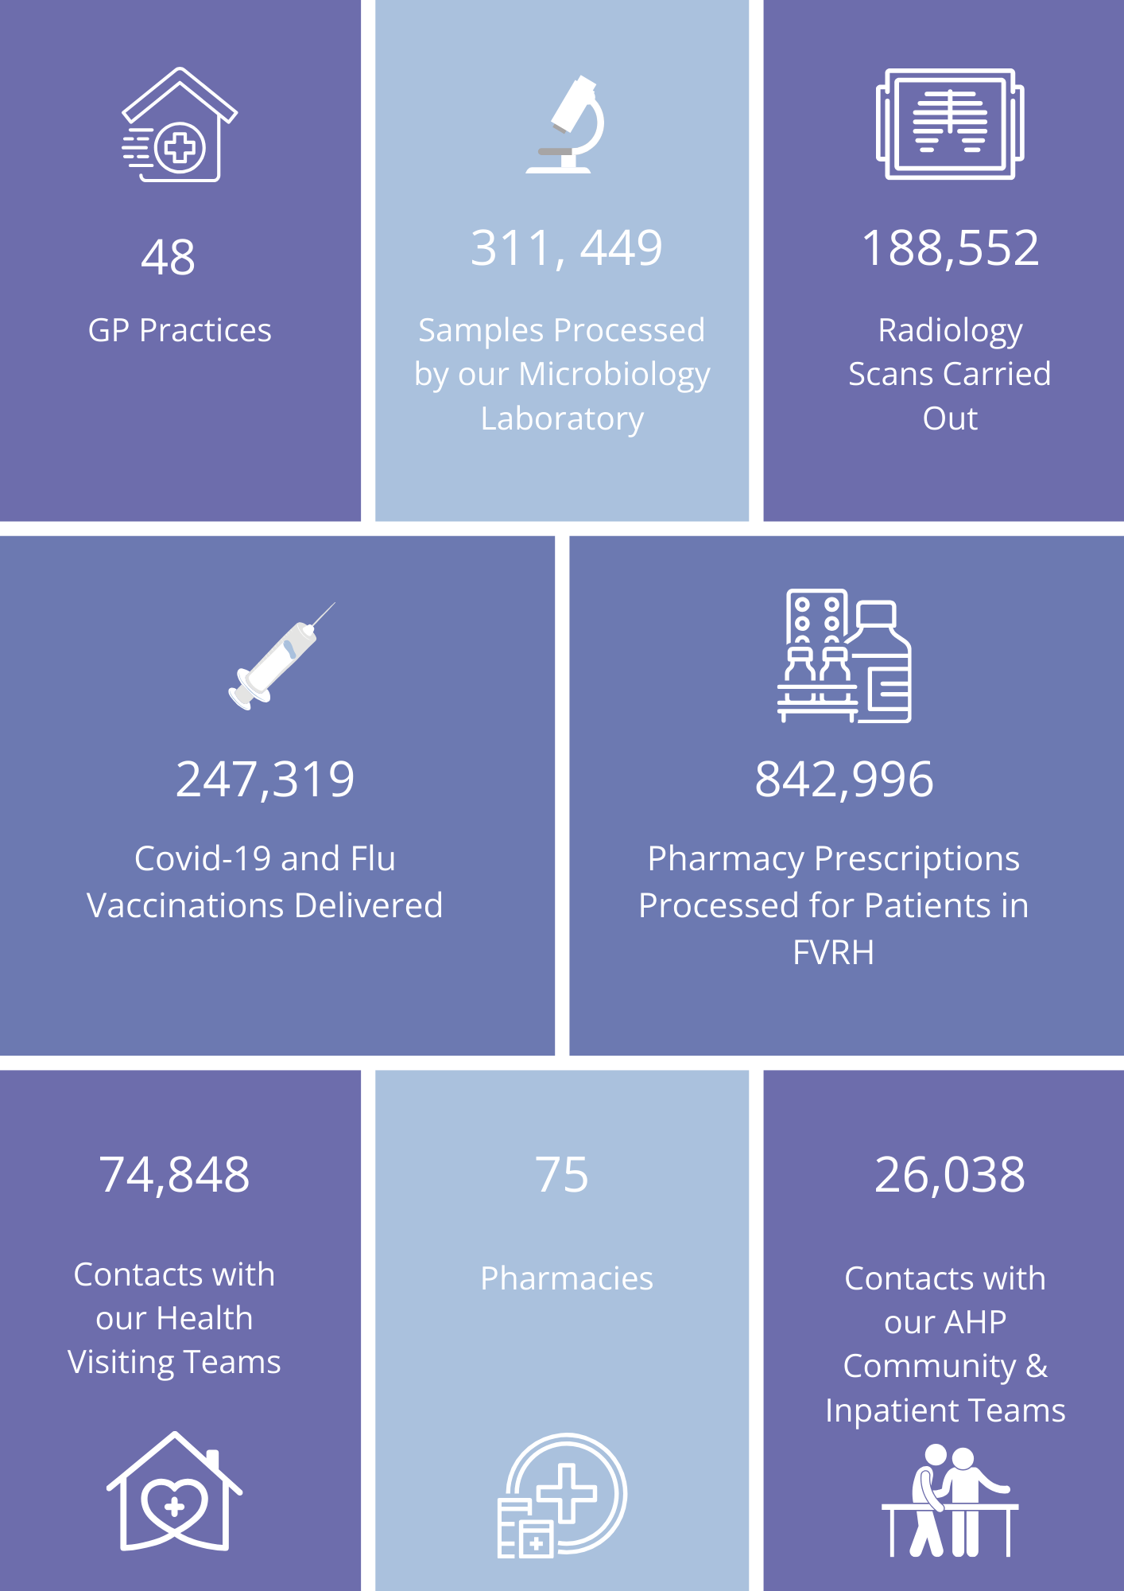
At a Glance

Slide 7
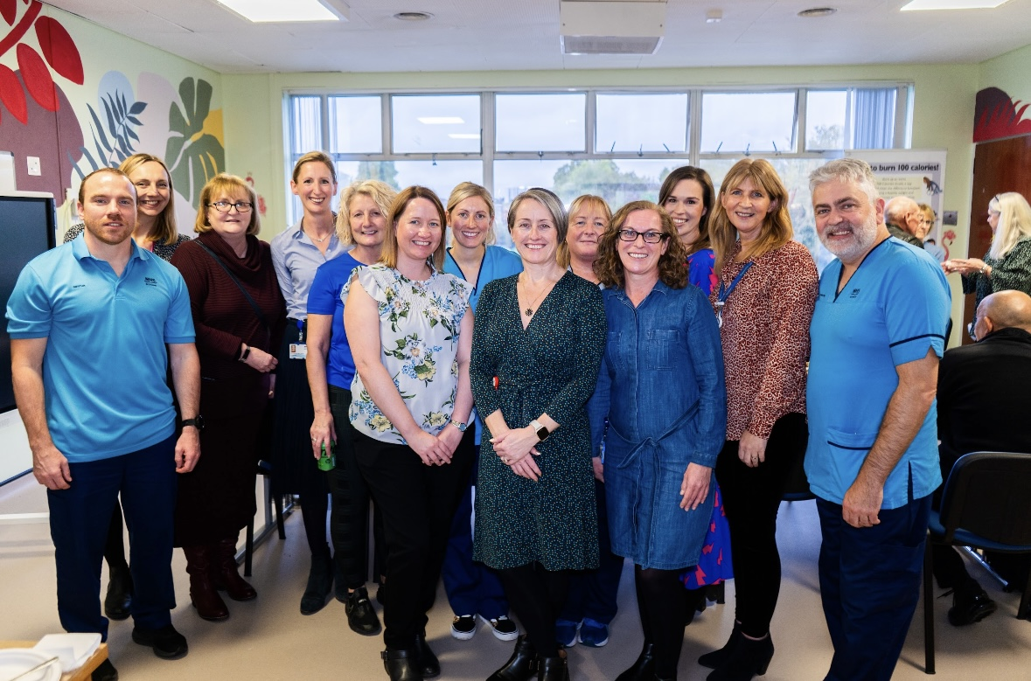
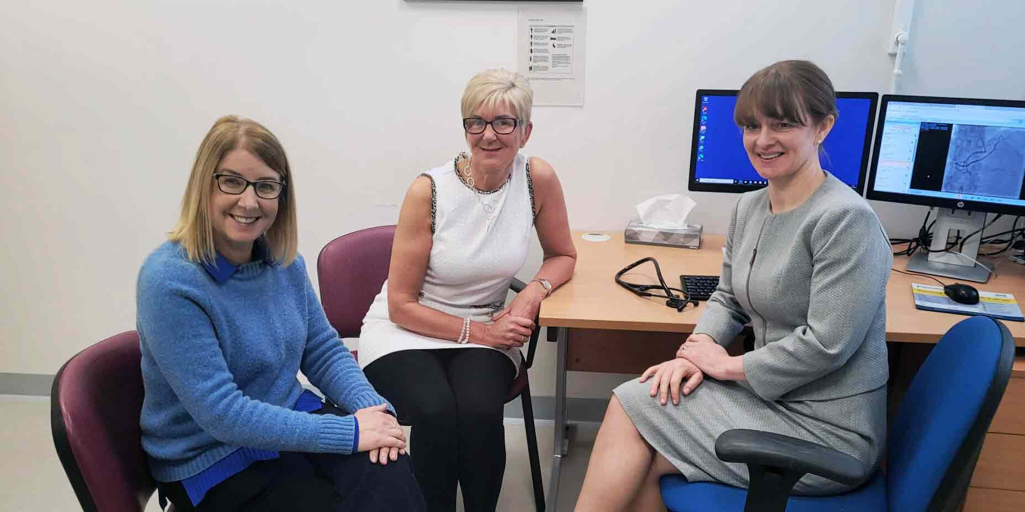
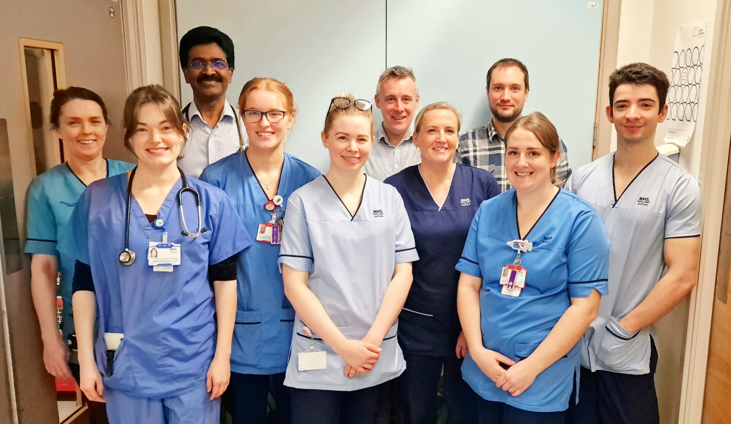
Service Developments
New care hub for people with diabetes
Specialist heart clinic for women
Long Covid service established
Improved services for stroke patients
Quicker referrals for suspected breast cancer

Slide 8
Improving Quality & Safety
Set ambitious targets to reduce incidence of
Pressure ulcers
Falls
Cardiac arrest rates
Catheter usage
Patients requiring enhanced observations

Slide 9
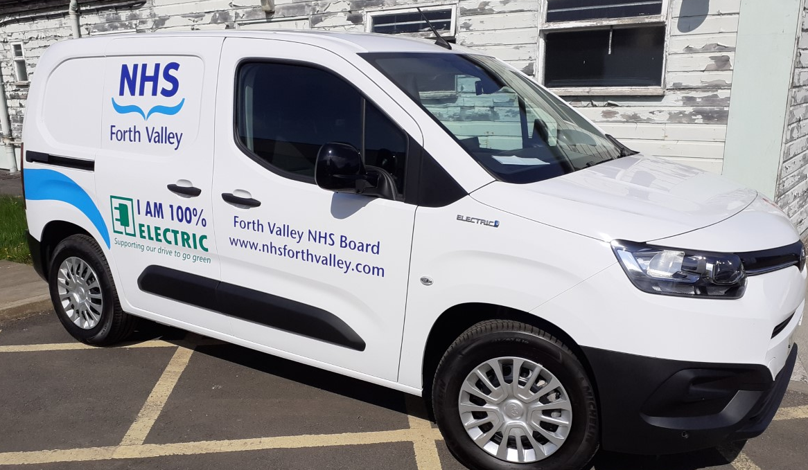
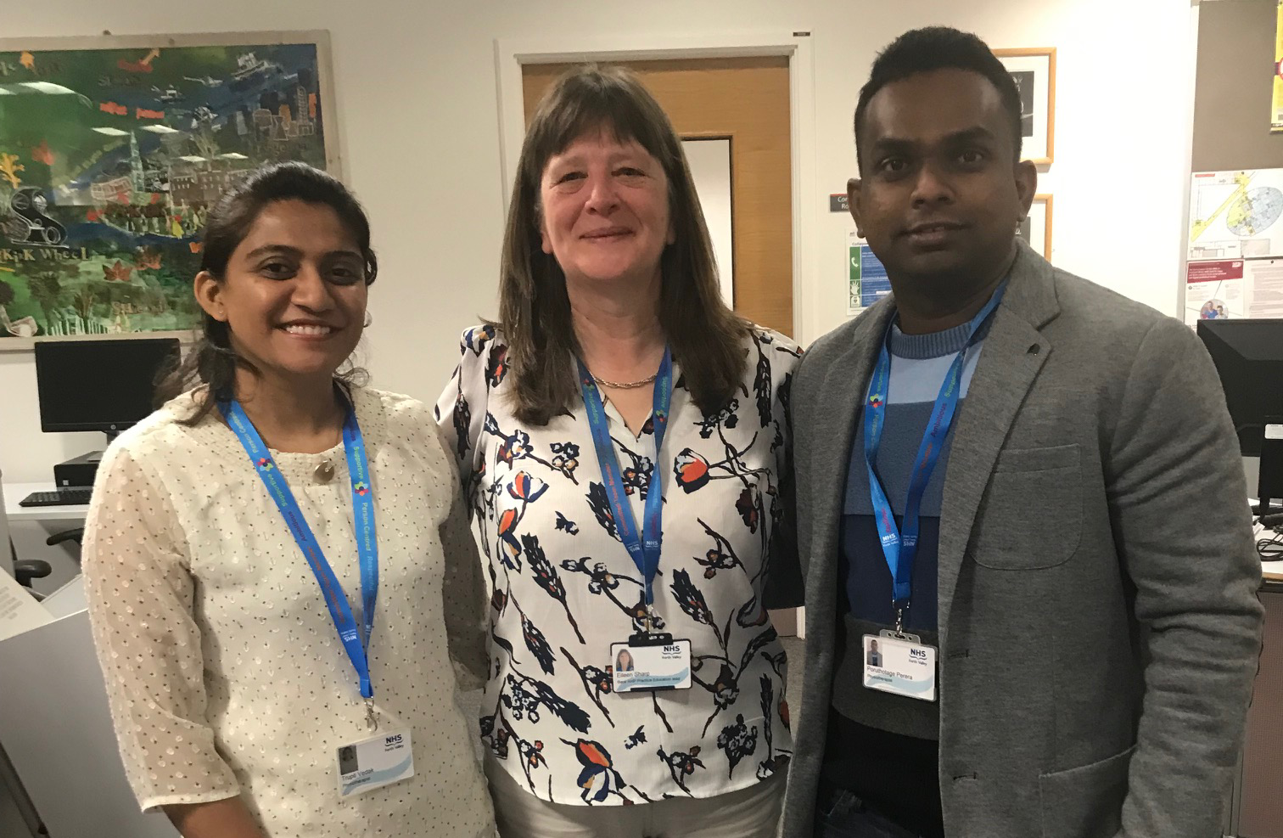
Key Achievements
Tackling climate change
Delivered balanced budget – 2023/24
Supporting clinical research
Recruitment – locally & overseas
Positive feedback from students

Slide 10
Key Challenges
Escalation
Financial pressures
Rising demand & complexity

Slide 11
Performance
Unscheduled Care
95% of patients should wait less than 4 hours from arrival to admission, discharge or transfer for accident and emergency treatment.
Performance in 2023/2024:
99.8% Minor Injuries Unit (99.7% in 2022/2023)
47.0% Emergency Department (47.5% in 2022/2023)
56.8% Forth Valley overall (61.7% in 2022/2023)

Slide 12
Primary Care
GP Out of Hours
In March 2024, there were 6,189 presentations to the GP Out of Hours service compared with 4,454 in March 2023.
The Out of Hours GP rota fill was 94% in March 2024 compared with 64% in March 2023.
GP headcount higher than 5 years ago - 220 in 2019 and 236 in 2024 however the wholetime equivalent is - 165 in 2019 and 169.8 in 2024.

Slide 13
Diagnostics
Patients should receive any of the following key diagnostic investigations within 6 weeks – Upper & Lower Endoscopy, Colonoscopy, Cystoscopy, CT Scan, MRI Scan, Barium Studies, Ultrasound.
Imaging
In March 2024, 36.2% of patients waited less than 6 weeks compared with 82.2% in March 2023. Improvement to 46.3% in the month of October 2024.
NHS Forth Valley delivered 96% of the planned activity agreed with Scottish Government.
Endoscopy
In March 2024, 63.1% of patients waited less than 6 weeks compared with 67.7% in March 2023. 63.4% in the month of October 2024.
NHS Forth Valley delivered 155% of the planned activity agreed with the Scottish Government.

Slide 14
Cancer
95% of patients referred urgently with a suspicion of cancer to begin treatment within 62 days of receipt of referral and, 95% of all patients diagnosed with cancer to begin treatment within 31 days of decision to treat.
62-day cancer target
In the quarter ending March 2024, 74.6% of patients with a suspicion of cancer were treated within 62 days compared with 70.2% in the quarter ending March 2023. Improvement to 82.1% in the quarter ending June 2024.
31-day cancer target
In the quarter ending March 2024, 99.0% of patients were treated within 31 days of decision to treat compared with 99.3% in the quarter ending March 2023. 99.7% in the quarter ending June 2024.

Slide 15
Planned Care - Outpatients
95% of new outpatients should receive an outpatient appointment within 12 weeks of receipt of referral.
In March 2024, 61.4%% of patients were waiting less than 12 weeks compared with 59.2% in March 2023. Improvement to 73.9% in the month of October 2024.
Total number of patients waiting for a first outpatient appointment at the end of March 2024 was 14,834 compared with 18,887 at the end of March 2023. Improvement to 12,520 in the month of October 2024.
NHS Forth Valley delivered 99% of the planned activity agreed with the Scottish Government.

Slide 16
Planned Care - Inpatients & Daycases
Patients should receive their treatment within 12 weeks of the treatment having been agreed.
In March 2024, 45.0% of patients were waiting less than 12 weeks compared with 49.8%% in March 2023. Improvement to 46.8% in the month of October 2024.
Total number of patients waiting for inpatient or daycase treatment at the end of March 2024 was 5,275 compared with 4,372 at the end of March 2023. 5,876 in the month of October 2024.
NHS Forth Valley delivered 119% of the planned activity agreed with the Scottish Government.

Slide 17
Mental Health
Psychological Therapies
90% of patients should start treatment within 18 weeks of referral.
In the quarter ending March 2024 68.9% of patients were seen within the 18-week referral to treatment standard compared with 71.1% in March 2023. 71.6% in the quarter ending June 2024.
Child & Adolescent Mental Health Services (CAMHS)
90% of patients to start treatment within 18 weeks of referral.
In the quarter ending March 2024, 92.8% of patients were seen within the 18-week referral to treatment standard compared with 42.5% in the quarter ending March 2023. 97.9% in the quarter ending June 2024.

Slide 18
Finance
All 3 mandatory financial targets set by Scottish Government were met for the financial year 2023/2024.
A surplus of £0.2m against the revenue resource limit of £840.6m.
A break-even position against the capital resource limit of £8.8m.
A break-even position against the cash requirement with a closing bank balance of less than £0.050m.

Slide 19
Future Priorities
New 10-year Population Healthcare Strategy
Financial sustainability
Value Based Health & Care
Ongoing work to improve our culture & the experience of local patients & staff

Slide 20
Questions

